Slide 1
Time fluctuations in density and dielectric constant of low and high density liquid water
ERIK LASCARIS, Boston University
Cui Zhang, UC Davis Giulia A. Galli, UC Davis Giancarlo Franzese, Universitat de Barcelona H. Eugene Stanley, Boston University

Slide 2
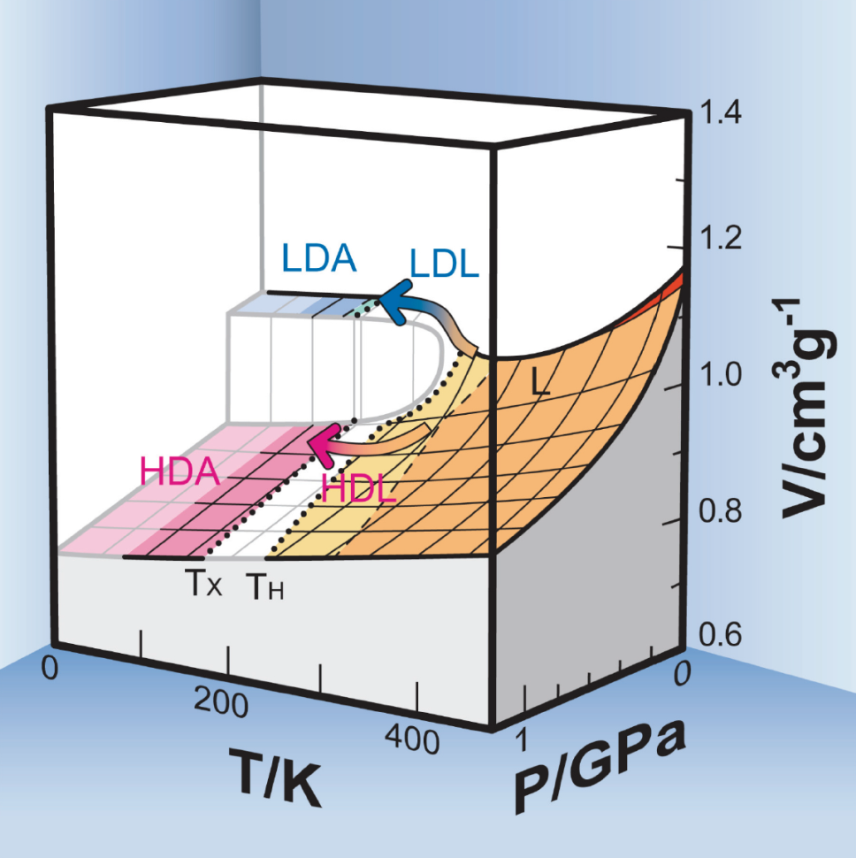
Liquid-Liquid Phase Transition
Hypothesis
(Poole/Sciortino/Essmann/Stanley, 1992)
Two liquids below nucleation temperature:
Low density liquid (LDL)
High density liquid (HDL)
Separated by liquid-liquid phase transition
Ending in liquid-liquid critical point
Cover of JPC, volume 115, 8 Dec 2011
Notes:
// so-called “no-man’s land”,… /// .currently inaccesible by experiments… ///There are two liquids below the homogeneous nucleation line: a low density liquid (LDL), and a high density liquid (HDL). These two liquids are separated by a first order (-like) phase transition, ending in a liquid-liquid critical point.

Slide 3
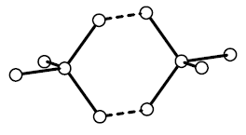
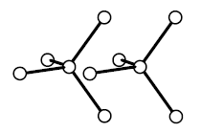
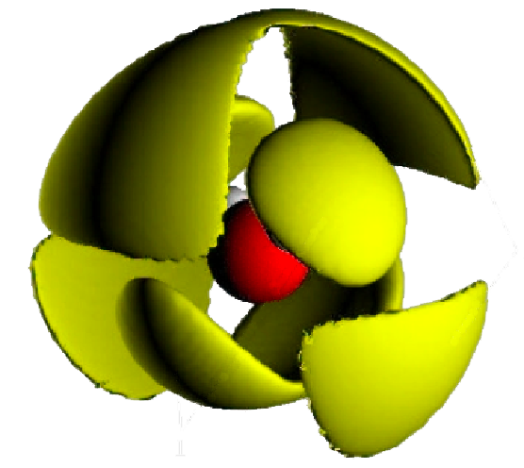
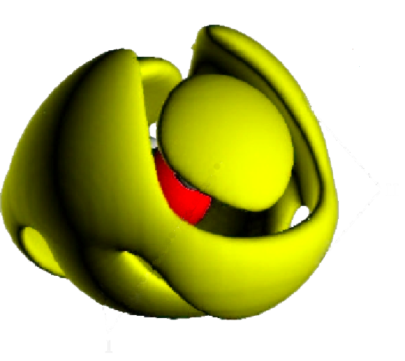
LDL vs. HDL
Low Density Liquid water
High Density Liquid water
Density: ρ ≈ 0.9 g/cm³
Diffusion: D ~ 10^{–7} cm²/s
More “structured”
Density: ρ ≈ 1.05 g/cm³
Diffusion: D ~ 10^{–6} cm²/s
More “liquid-like”
Mishima & Stanley, 1998
Soper & Ricci, 2000
Notes:
Todo: Show here pictures of LDL and HDL / Indicate some differences [density, structure]

Slide 4
LDL vs. HDL
But nothing is known about their dielectric properties!
How much does dielectric constant differ between LDL / HDL?
How do the dielectric properties of LDL / HDL depend on time?
How do dipole fluctuations differ in LDL / HDL?
Do dipole correlations change in time and space?
Notes:
Todo: Show here pictures of LDL and HDL / Indicate some differences [density, structure]

Slide 5
LDL vs. HDL
But nothing is known about their dielectric properties!
How much does dielectric constant differ between LDL / HDL?
How do the dielectric properties of LDL / HDL depend on time?
How do dipole fluctuations differ in LDL / HDL?
Do dipole correlations change in time and space?
Work in progress!
Notes:
Todo: Show here pictures of LDL and HDL / Indicate some differences [density, structure]

Slide 6
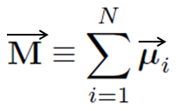
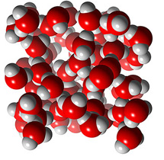
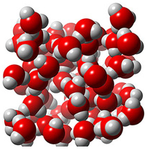
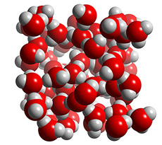
Step 1: Total dipole moment M
Simply the sum of all molecular dipoles μ_{i} :
Is non-zero even without external E field
Notes:
// changes in magnitude and direction

Slide 7
Step 2: Dielectric constant ε
For non-polarizable systems:
For pure water ε ≈ 80 ≫ 1, so:
(for Reaction Field)
Neumann and Steinhauser, 1983
Notes:
Note: var(M) might depend on rho and T as well – so our main focus is on M

Slide 8
Research Methods
ST2 potential for water (Stillinger & Rahman)
Molecular Dynamics, up to 1000 ns
Finite size scaling with N = 216, 343, 512, 729
Constant pressure / constant temperature (NPT)
Reaction Field method
No pressure correction for L-J cutoff
Notes:
As indicated in the title of this talk, we did all our simulations with the ST2 model introduced by Stillinger and Rahman in 1974…

Slide 9
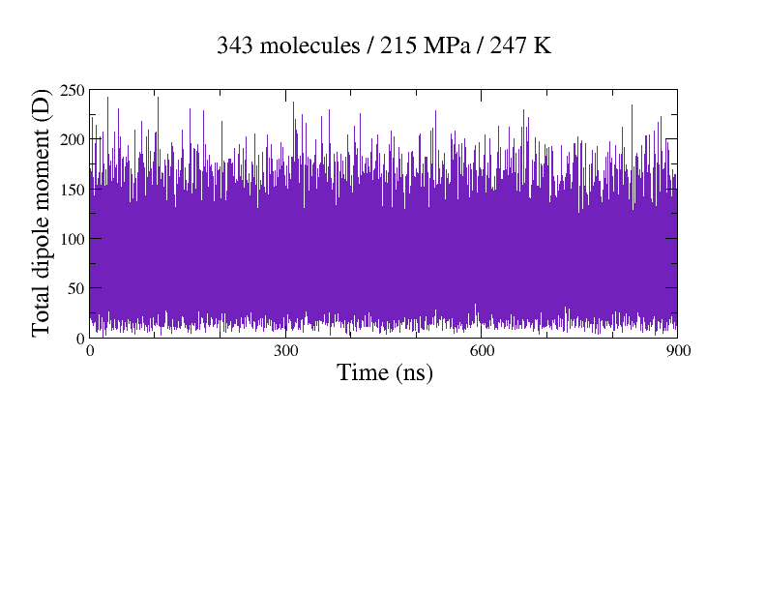
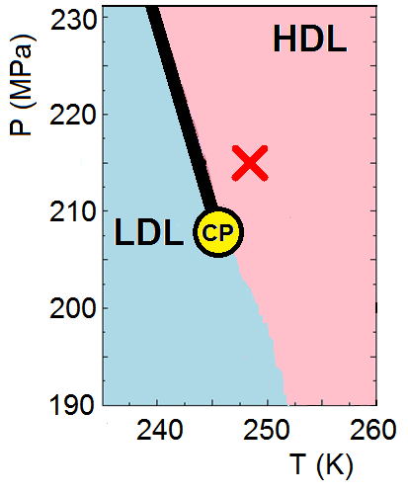
Total dipole moment |M| in HDL

Slide 10
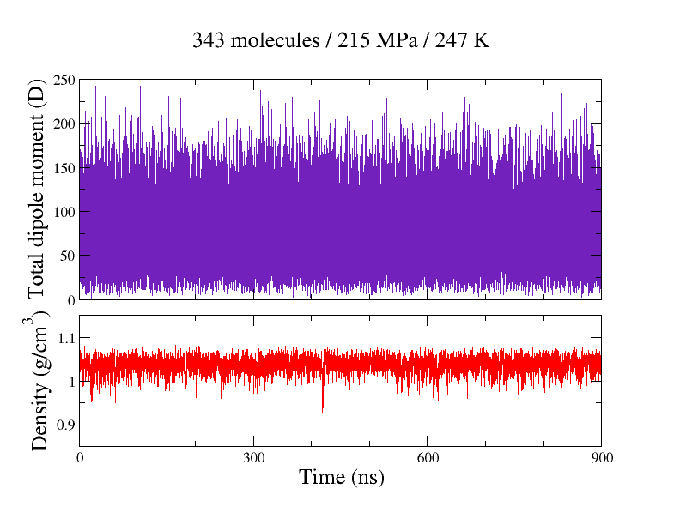
Total dipole moment |M| in HDL
ε ≈ 143

Slide 11
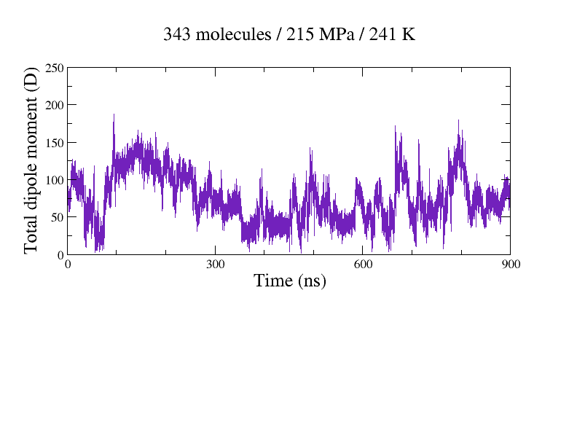
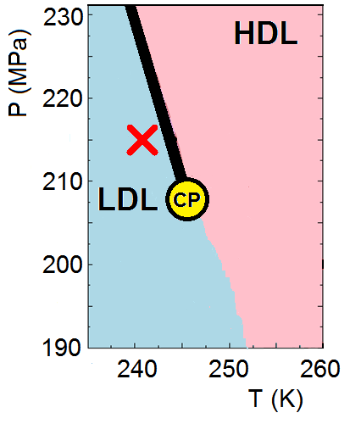
Total dipole moment |M| in LDL

Slide 12
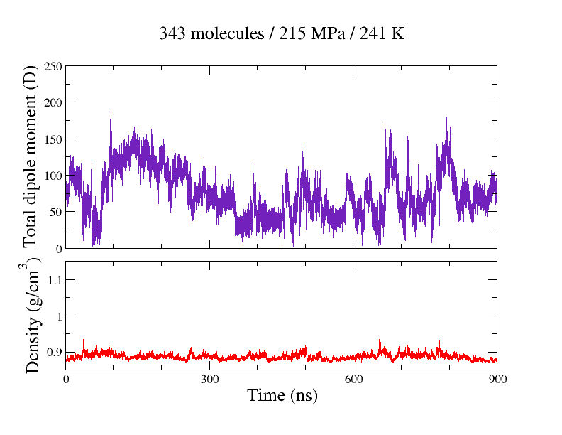
Total dipole moment |M| in LDL
ε ≈ 100

Slide 13
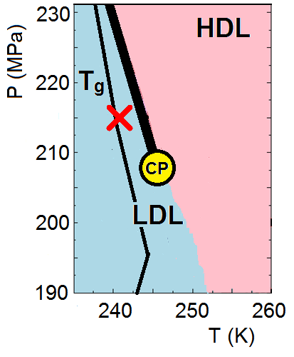
Total dipole moment |M| in LDL
Fluctuations of system dipole moment also τ ∼ 100 ns
Near glass transition characteristic time for LDL is τ ∼ 100 ns
T. Kesselring, et. al. arXiv:1112.2186

Slide 14
Conclusions
Total dipole moment M evolves with time very differently for HDL and LDL
Dielectric constant for HDL is about 50% larger than for LDL
Partially because ε ∝ ρ
Mostly because of M
Works in progress on dipole fluctuations & dipole correlations to provide more insight
Notes:
One important property is the dielectric constant…

Slide 15
Thank you!
Thank you!

