Slide 1
Generalized Preferential Attachment Model (GPMG)

Slide 2
The goal of the model is to explain stylized facts
Assumption of the model

Slide 3
(1) Sales distribution is skewed world wide pharmaceutical database

Slide 4
Number of products in the pharm firms

Slide 5
(2) Growth rate distribution

Slide 6
(3,4) average growth rate and its std.

Slide 7
GPMG=Bose-Einstein + Simon + Gibrat

Slide 8
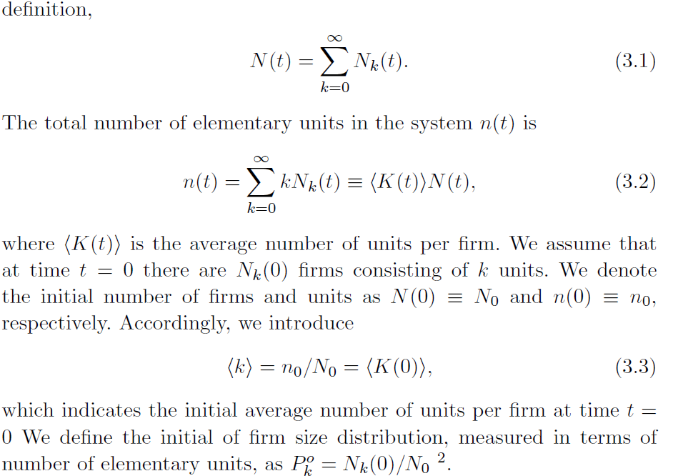
First set of Assumptions

Slide 9
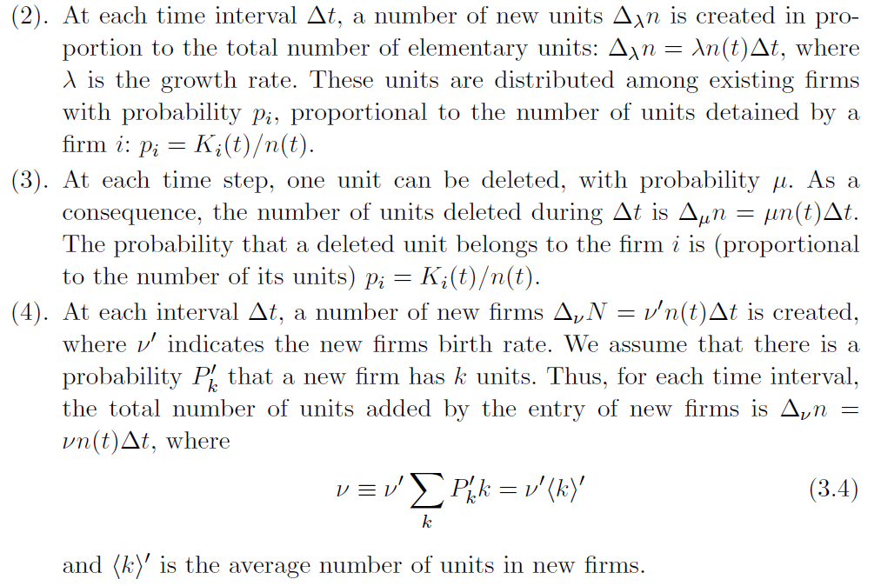
(2-3) Bose-Einstein ; (4) Simon

Slide 10
Second set of Assumptions (Gibrat Law)

Slide 11
Pure Gibrat Model
Stilized Facts (2-4) are violated:
(2) The shape of the growth rate is parabolic
(3,4) The Growth rate and variance are independent
of firm size.
Moreover, variance grows linearly with time

Slide 12
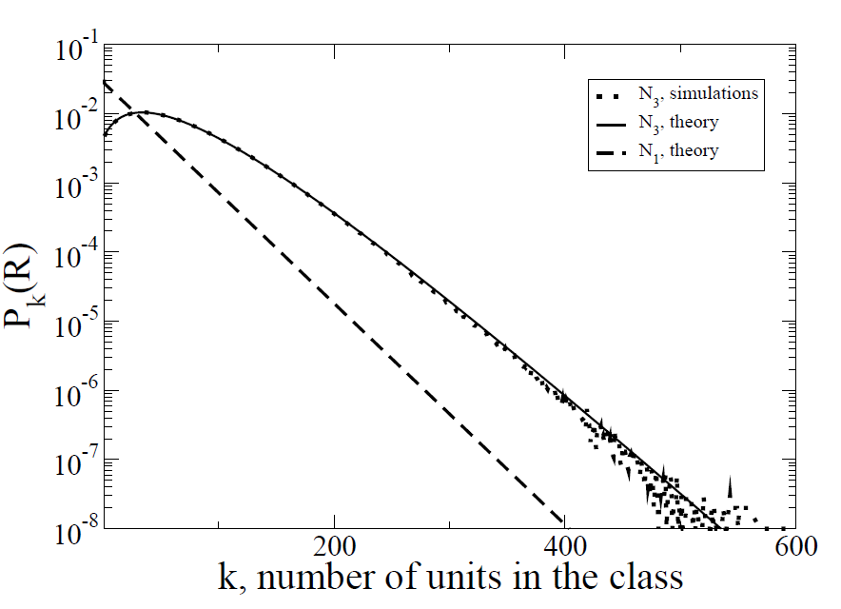
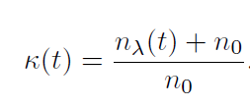
Pure Bose-Einstein: no new firms
Size distribution is Geometric
Innovation parameter
Number of active firms

Slide 13
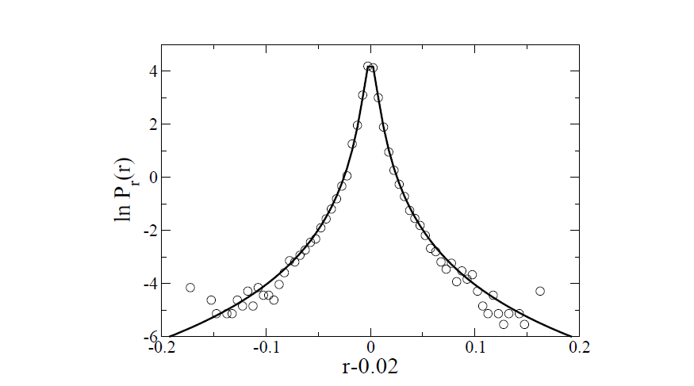
Growth rate is tent shape

Slide 14
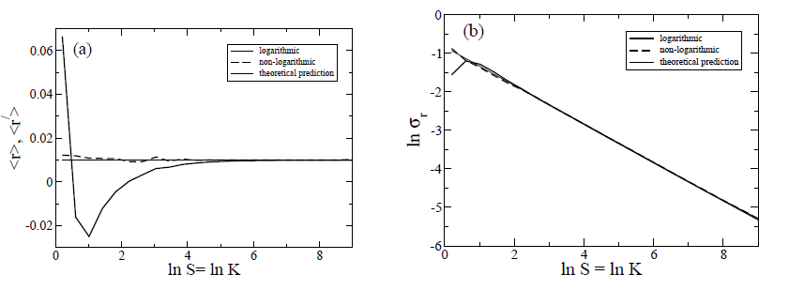
Stylized Facts 3-4 are violated
In reality =0.24

Slide 15
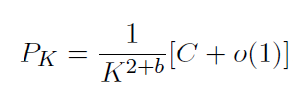
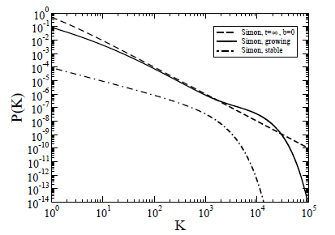
Simon Model: new firms can be created
Finite time

Slide 16
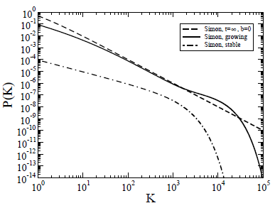
Finite time Behavior
Growth Factor of the Economy
Old Firms
New Firms : Crossover from power law
for K<<R to exponential for K>>R

Slide 17
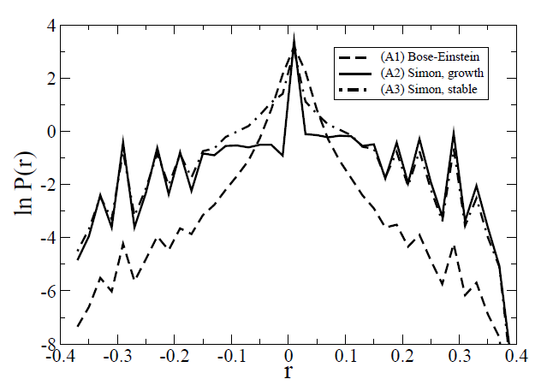
Growth rate : disaster!

Slide 18
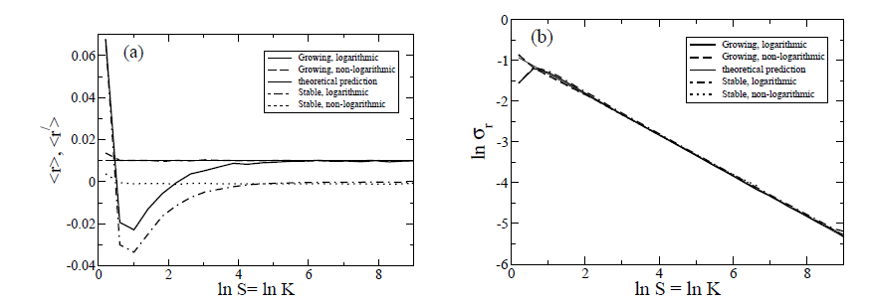
Stylized Facts (3,4): Same as Bose.

Slide 19
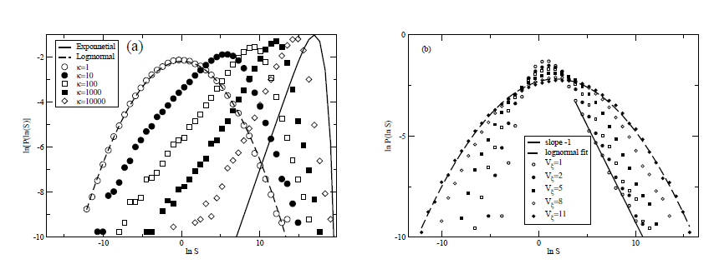
Full Blown GPMG
No analytical formula for
the sum of Lognormals!!!

Slide 20
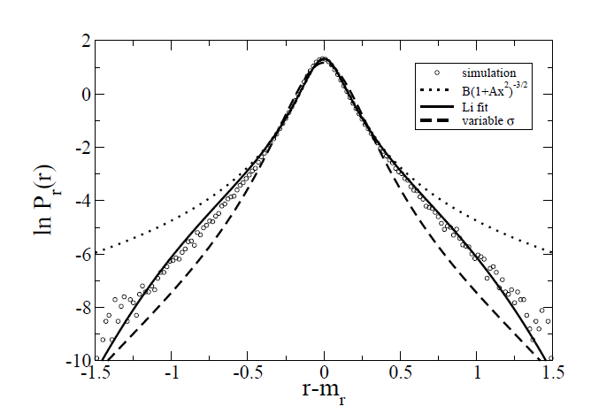
Growth rate for Bose-Einstein

Slide 21
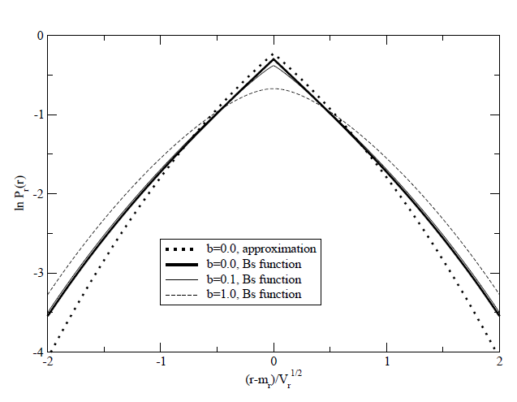
Growth rate for Simon
Laplassian Cusp

Slide 22
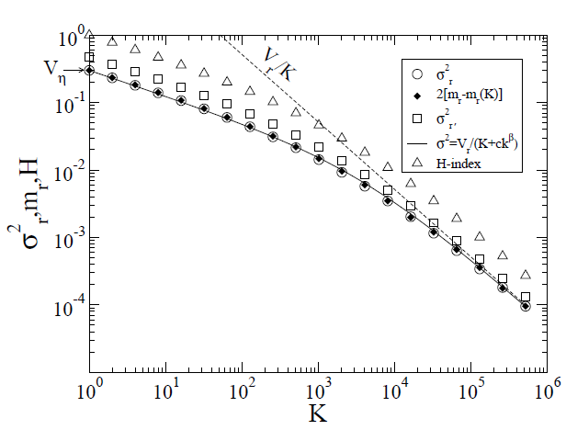
Size variance

